Slide 1



Accelerate
Phase I Report-Out
Template

Slide 2
Supplier Company Overview
Company Size: (total annual sales, # employees)
Core Products/Services:
Brief description of Lean Journey previous to Accelerate: (use of lean tools, to what extent, resources devoted to Continuous Improvement activities, etc.)

Slide 3
Accelerate Charter Highlights
Project Scope: Part or Part Family selected for mapping activities
Business Case:
- Overall volume of Business between Supplier and OEM
- Volume of business represented in Value Stream selected for Accelerate project

Slide 4
Project Team Members
Names, Titles
Names, Titles
Names, Titles
Names, Titles
Names, Titles
Names, Titles
Names, Titles

Slide 5
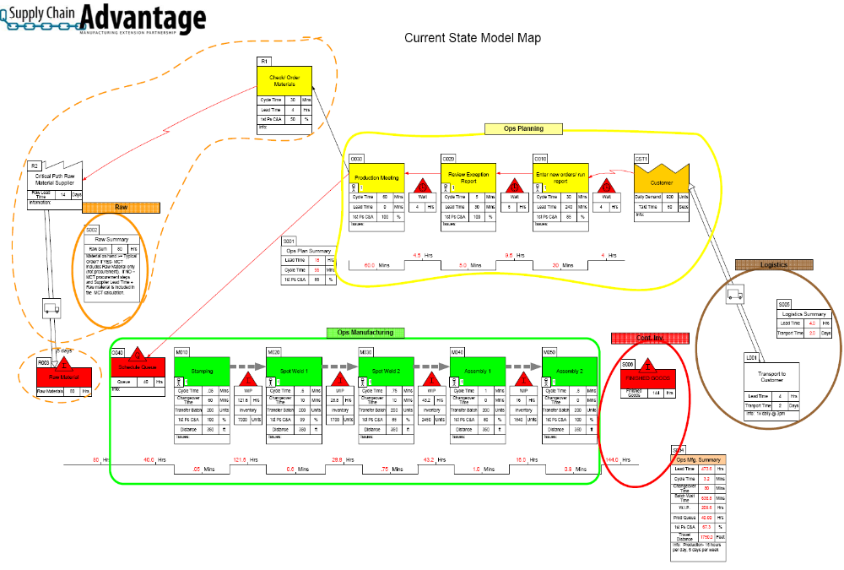
Phase I - Current State VSM

Slide 6
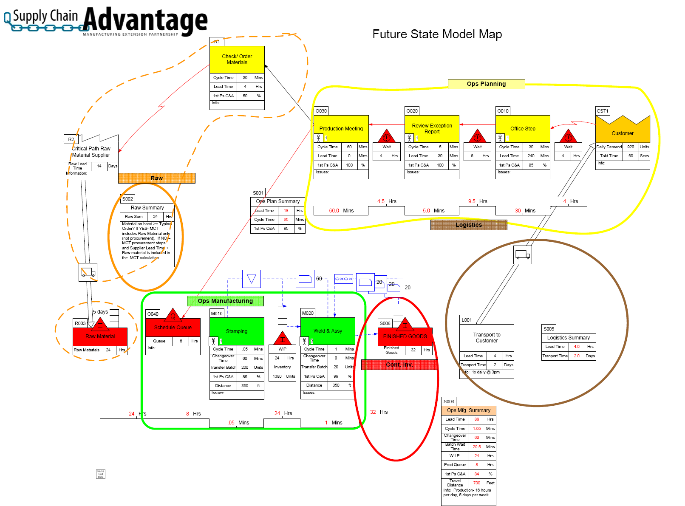
Phase I - Future State VSM

Slide 7
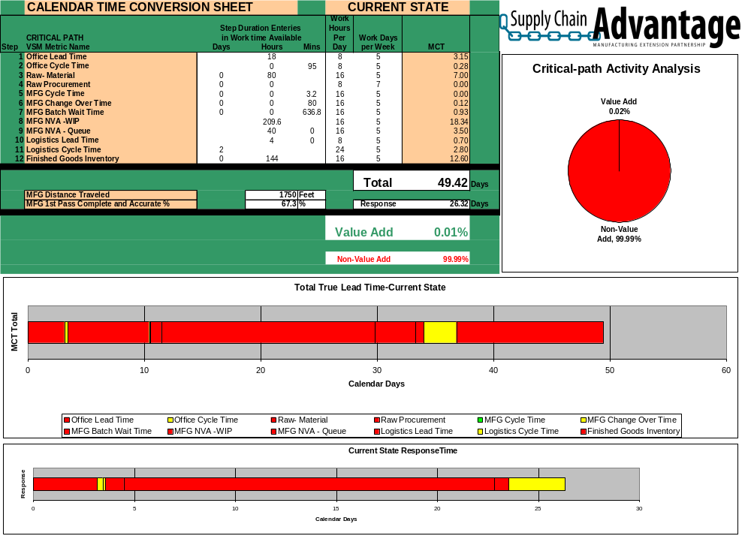
Phase I - Current State MCT

Slide 8
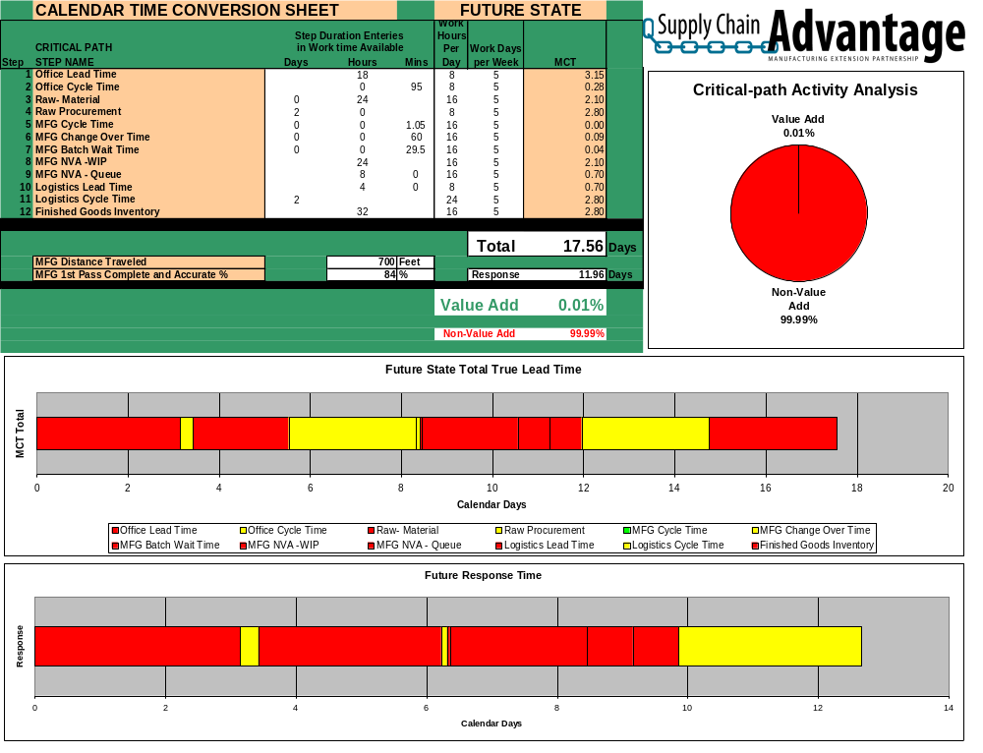
Phase I – Future State MCT

Slide 9
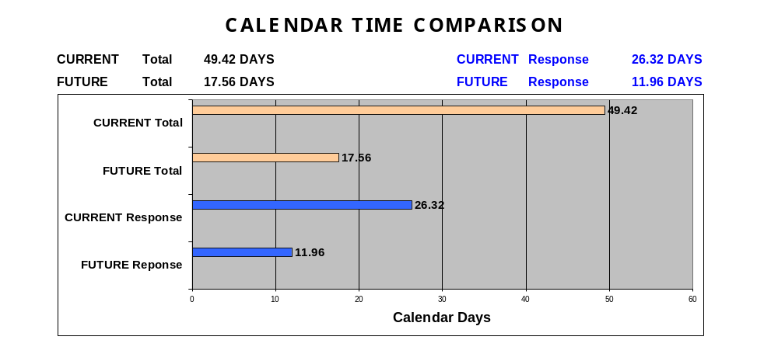
Phase I

Slide 10
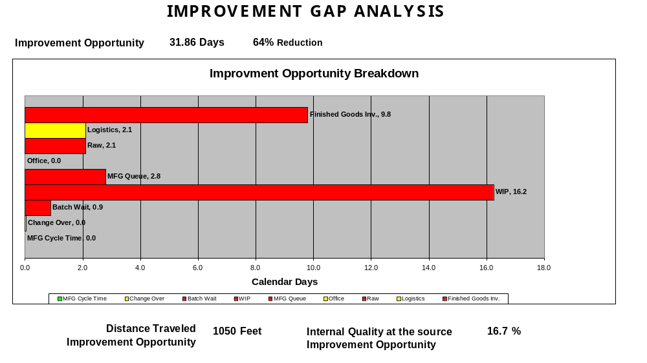
Phase I

Slide 11
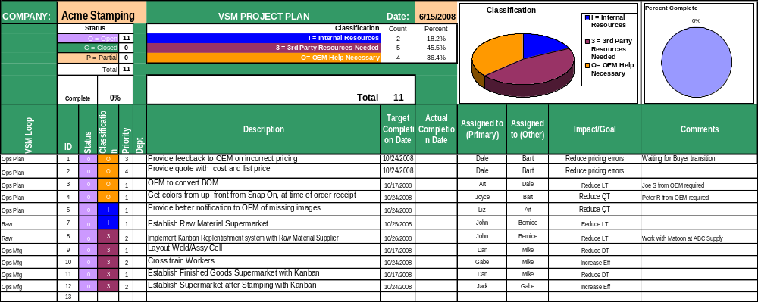
Phase I – Project Plan

Slide 12
Feedback and Planning
OEM Feedback and Questions
Schedule Tentative Phase 2 Report-Out Meeting Date

Slide 13
Accelerate
Phase II Report-Out
Template

Slide 14
Accelerate Charter Highlights Review
Phase II
Project Scope: Part or Part Family selected for mapping activities
Business Case:
- Overall volume of Business between Supplier and OEM
- Volume of business represented in Value Stream selected for Accelerate project

Slide 15
Phase II - Future State VSM Review

Slide 16
Implemented Improvements Overview
Phase II
High-level Completed Project List
Completed Project 1
Completed Project 2
Completed Project 3
Completed Project 4

Slide 17
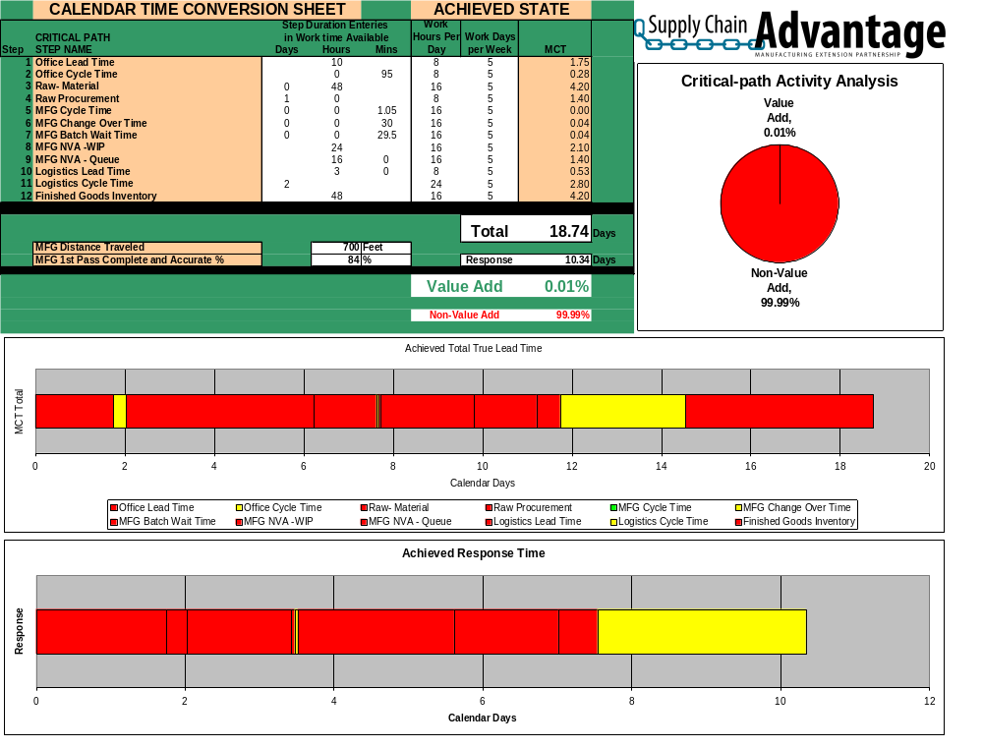
Phase II – Achieved State MCT

Slide 18
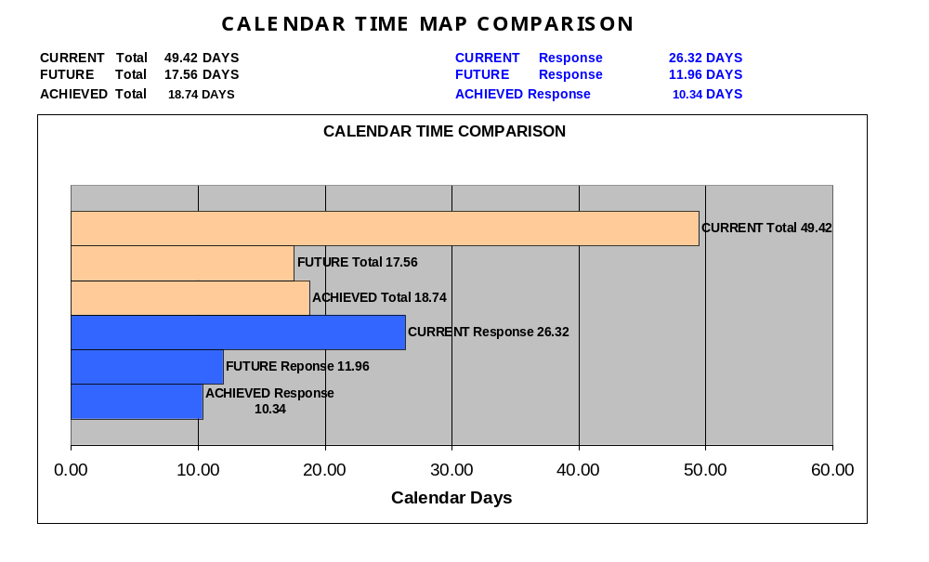
Phase II

Slide 19
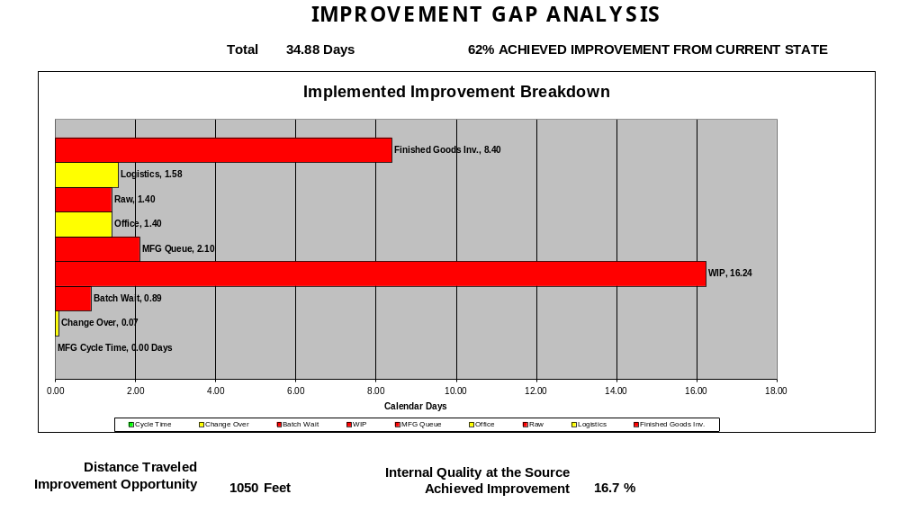
Phase II

Slide 20
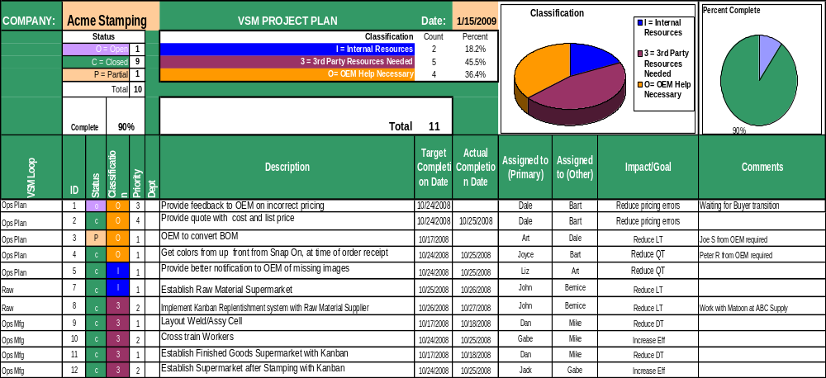
Updated Project Plan
Phase II

Slide 21
“Next Steps”
1 Year Continuous Improvement Plan
Target Improvement Areas:
Leadership Assigned:
Additional Resources:
Expected Outcomes:
Timeline:

Slide 22
Supplier Project Evaluation
Phase II
Lessons Learned:
Benefits:
Open Issues:
Additional Feedback:

Slide 23
Phase II
OEM Feedback
OEM Feedback and Questions

